Slide 1
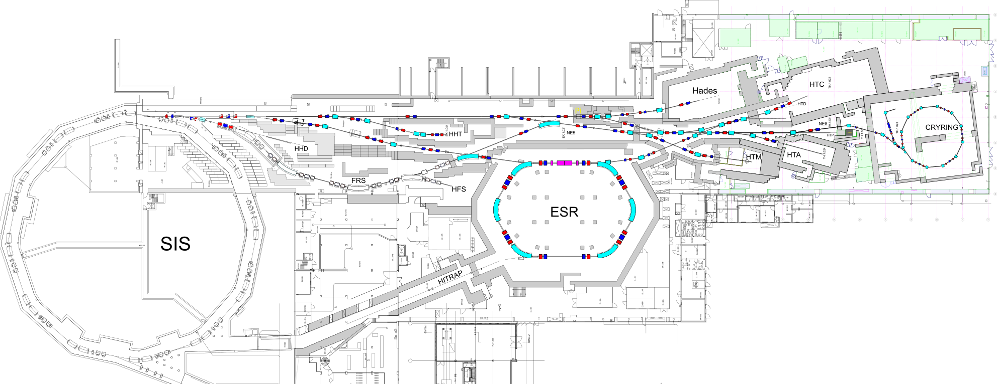
Upgrade for mCBM + R3B
Expected Beam Parameters:
extraction type: slow particles species: up to Au particle number: up to 10⁸ pps particle energy: up to1.24GeV/u

Slide 2
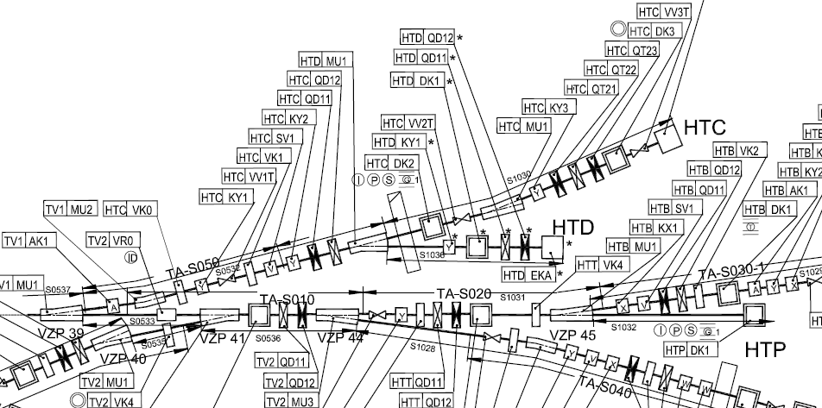
Upgrade for mCBM 3 x mCBM + 1 x R3B
GHTCDF3
GHTCDF1
HTD Dump
GHTDDF1

Slide 3
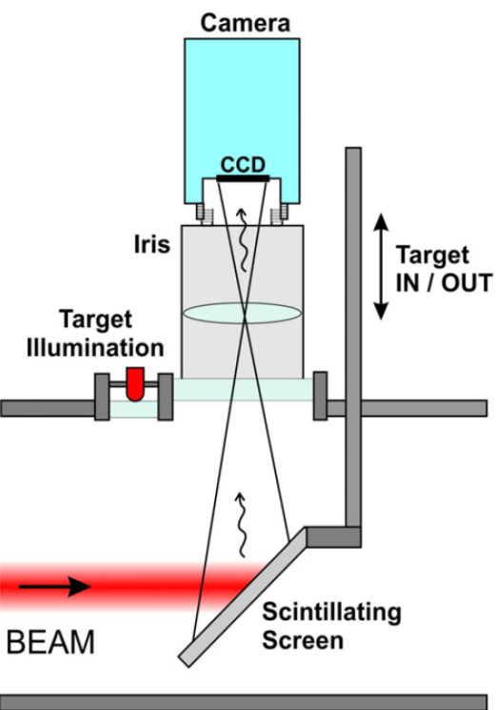
System Aufbau
Radiation
Save Area
Experiment Beamline
Control Rooms
Electronics Room
camera image / settings
User Clients
Frontend
camera DAQ
PLC control
local network
Connector Box
timing network
Timing Receiver
10 Gbit Switch
(local network)
trigger & power
iris & LED control
CPS8
PLC
Main Controller
PLC
Satellites
Profinet

Slide 4
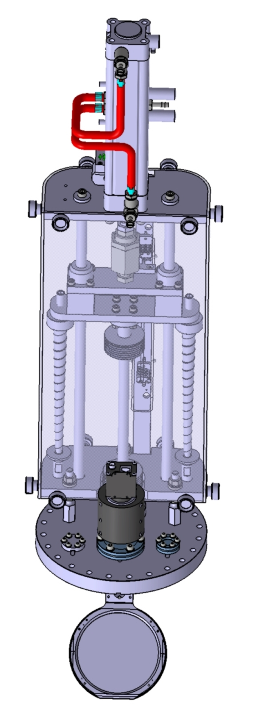
Upgrade for mCBM + R3B:
Mechanics
Mechanische Upgrade Leuchttarget-Antriebe Strahlführung zum mCBM und R3B
Position GHTCDK1:
Zusammenbau neue Vakuumkammer, Leuchttargetantrieb und Targets
Einbau und Justage Leuchtargetantrieb
Einbau der Kammer in Strahlführung
Feinjustage der Kammer in Strahlführung
Position GHTDDK1:
Zusammenbau neue Vakuumkammer, Leuchttargetantrieb und Targets
Einbau und Justage Leuchtargetantrieb
Einbau der Kammer in Strahlführung
Feinjustage der Kammer in Strahlführung
Position GHTCDK3:
Umbau alte Vakuumkammer, Leuchttargetantrieb und Targets
Einbau und Justage Leuchtargetantrieb
Einbau der Kammer in Strahlführung
Feinjustage der Kammer in Strahlführung
Position HTD Dump:
nur Kabel

Slide 5
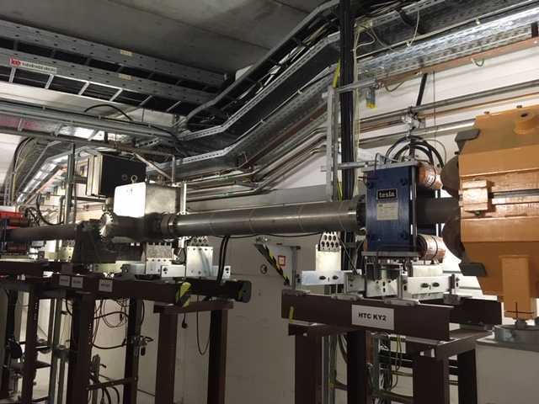
IST Zustand NE8 Position GHTCDK1

Slide 6
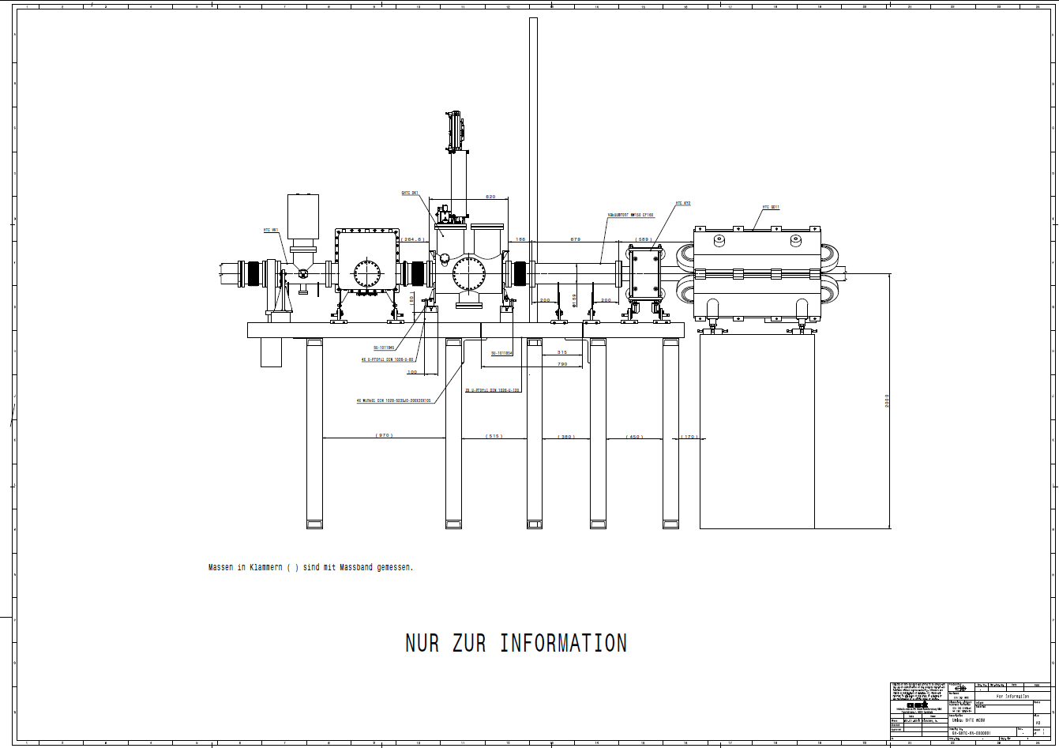
Upgrade for mCBM : GHTCDK1

Slide 7
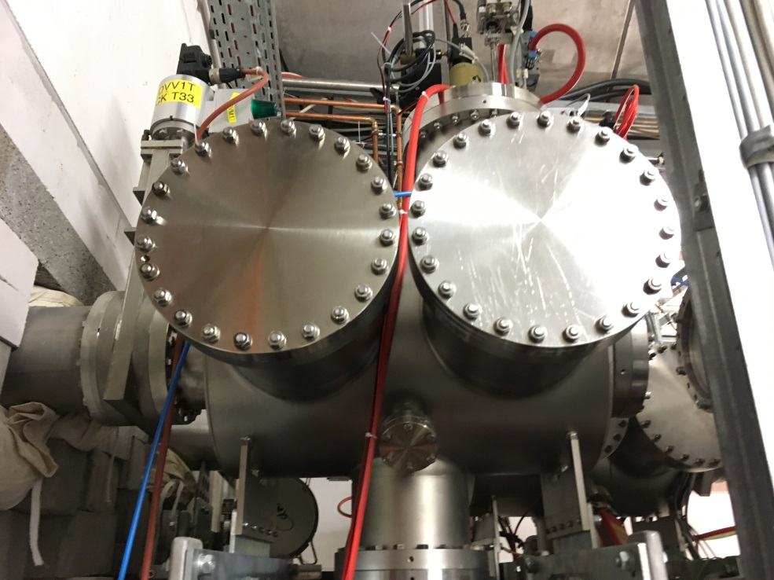
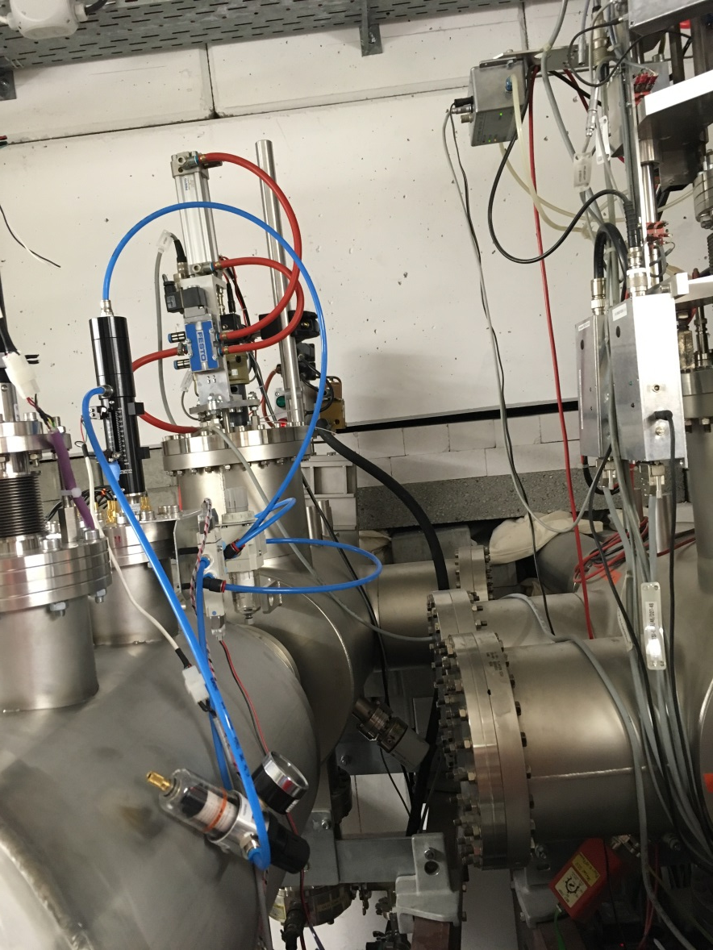
IST Zustand Position GHTDDK1

Slide 8
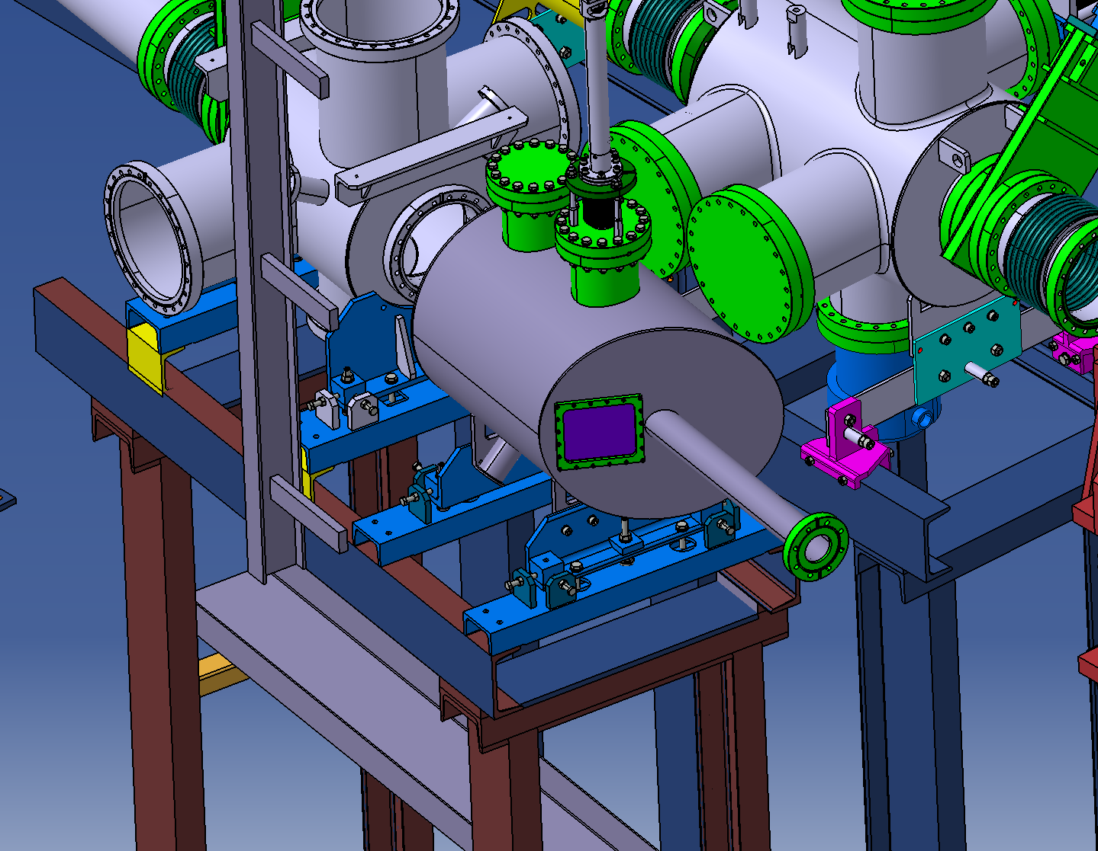
Upgrade for mCBM : GHTDDK1

Slide 9
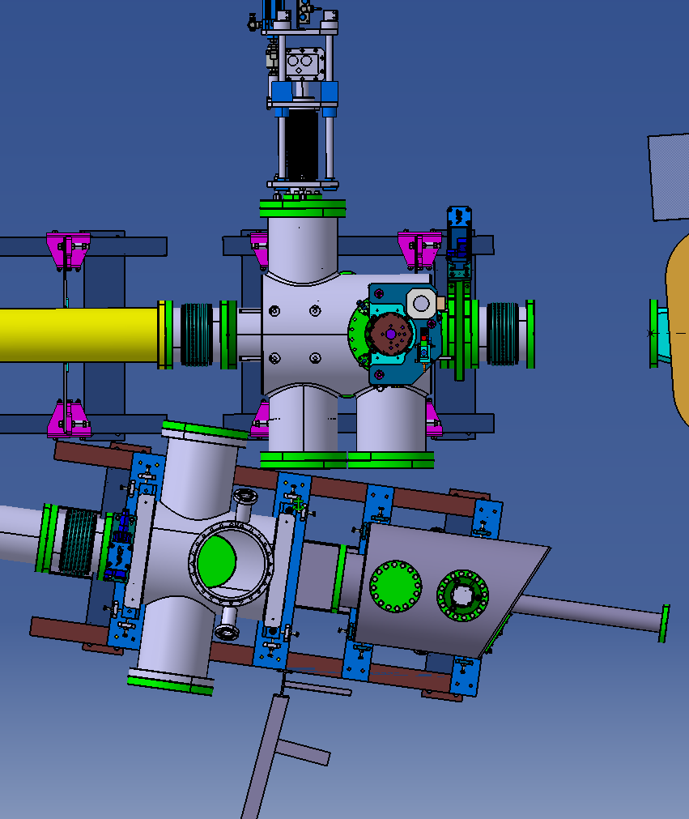
Upgrade for mCBM : GHTDDK1
ca. 60mm
GHTC DF um 180° gedreht
Balg 186mm
Schieber 70mm

Slide 10
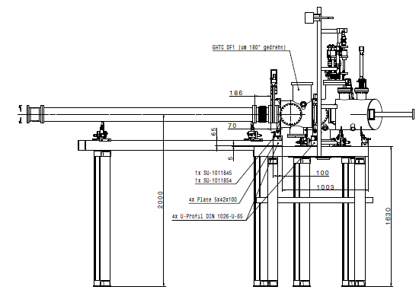
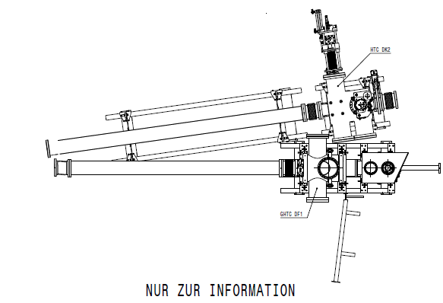
Upgrade for mCBM : GHTDDK1

Slide 11
Upgrade Kabelsatz
Position GHTCDK1:
1x halogen free UNITRONIC S/FTP CAT7 LSZH 4x2xAWG23 (network cable for camera data signals)
1x halogen free DATAFLAMM-C 5x0.14mm2 (between PLC and Adapter box)
1x halogen free DATAFLAMM-C PAAR 5x2x0.14mm2 (between CPS8 and Adapter box)
Position GHTDDK1:
1x halogen free UNITRONIC S/FTP CAT7 LSZH 4x2xAWG23 (network cable for camera data signals)
1x halogen free DATAFLAMM-C 5x0.14mm2 (between PLC and Adapter box)
1x halogen free DATAFLAMM-C PAAR 5x2x0.14mm2 (between CPS8 and Adapter box)
Position GHTCDK3:
1x halogen free UNITRONIC S/FTP CAT7 LSZH 4x2xAWG23 (network cable for camera data signals)
1x halogen free DATAFLAMM-C 5x0.14mm2 (between PLC and Adapter box)
1x halogen free DATAFLAMM-C PAAR 5x2x0.14mm2 (between CPS8 and Adapter box)
Position HTD Dump:
1x halogen free UNITRONIC S/FTP CAT7 LSZH 4x2xAWG23 (network cable for camera data signals)
1x halogen free DATAFLAMM-C 5x0.14mm2 (between PLC and Adapter box)
1x halogen free DATAFLAMM-C PAAR 5x2x0.14mm2 (between CPS8 and Adapter box)

Slide 12
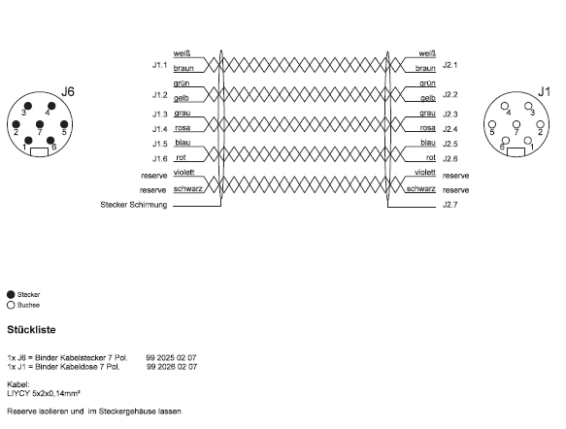
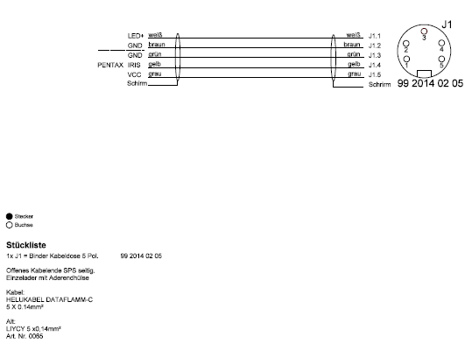
Stecker Belegung
CAT7 wird mit Stecker in Cave bestückt und in Elektronik Rack wird die andere ende auf die Patch-Panel befestigt

Slide 13
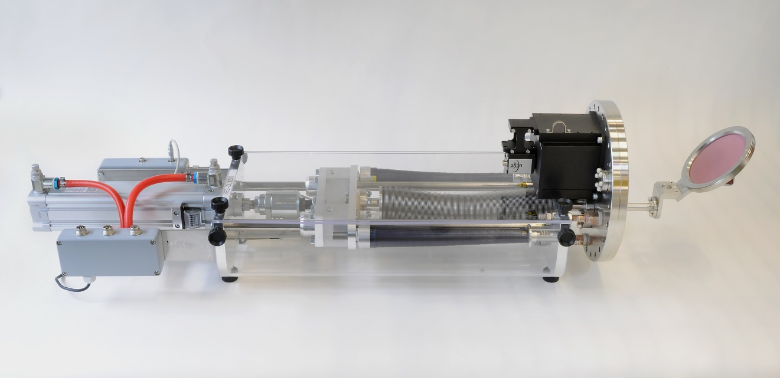
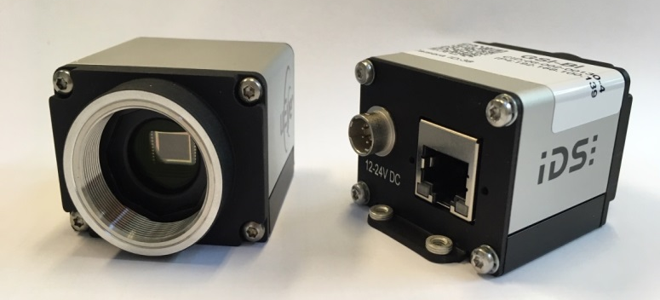
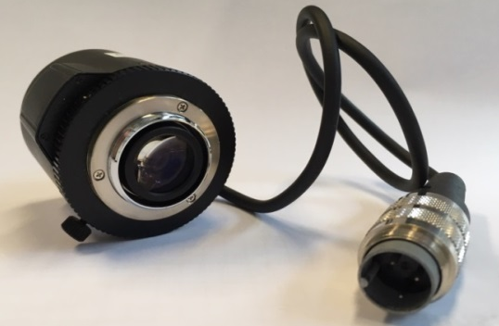
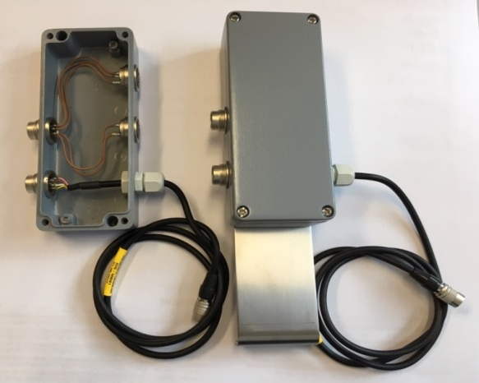
Mechanik und Optik
CMOS Camera requirements
Type |  | IDS uEye UI-5240SE-M-GL CMOS digital camera, monochrome
remote-controlled iris Pentax C1614ER
SCR Material | Type | Application
Al2O3:Cr (Chromox) | Solid target material (Active Area D100mm) | Standard light applications

Slide 14
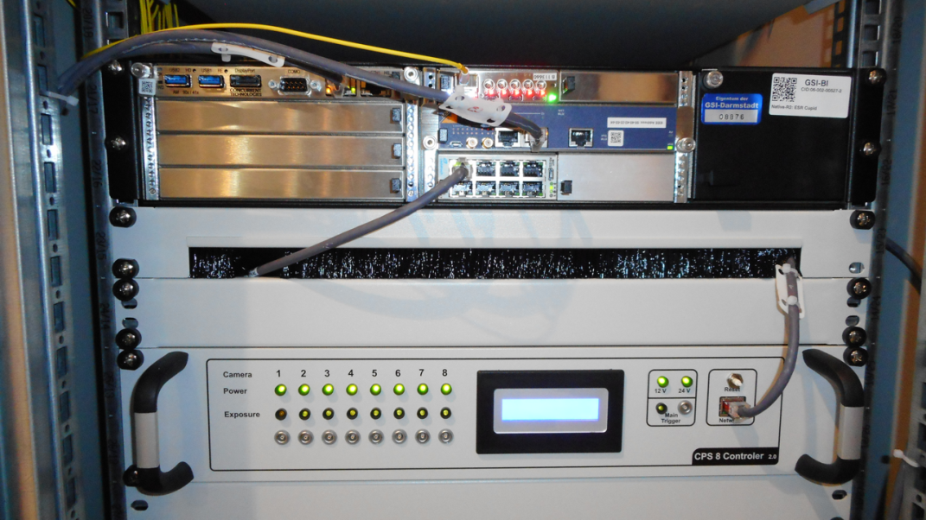
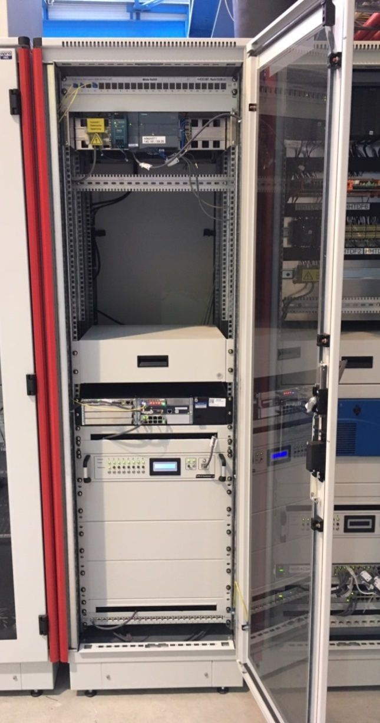
Rack für DAQ: Dach Cave A
HW Component | Type |  | Remarks
µTCA System | GSI-NATIVE-R2-AM902-AC | CoreI7 CPU 600W Power Supply 6-Slot MTCA.4 Chassis 2U NAT MCH | NAT and Powerbridge
Timing | AMC FTRN |  | Cosylab
Switch | AMC217 | 8-Port Switch AMC | Vadatech

Slide 15
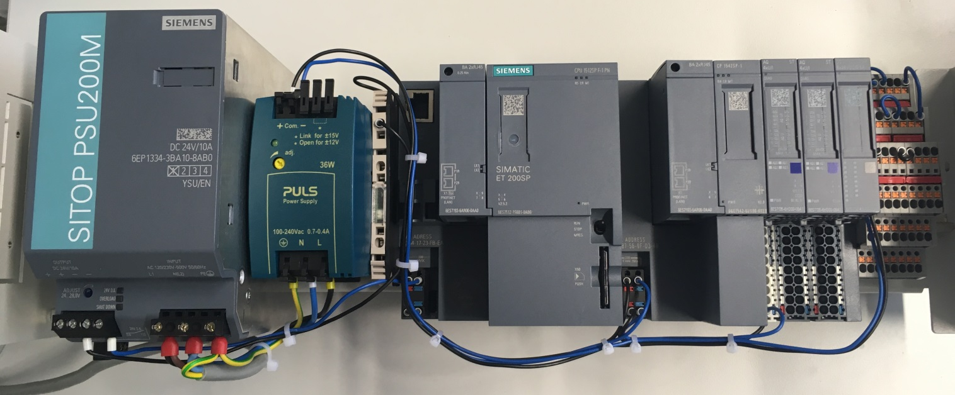
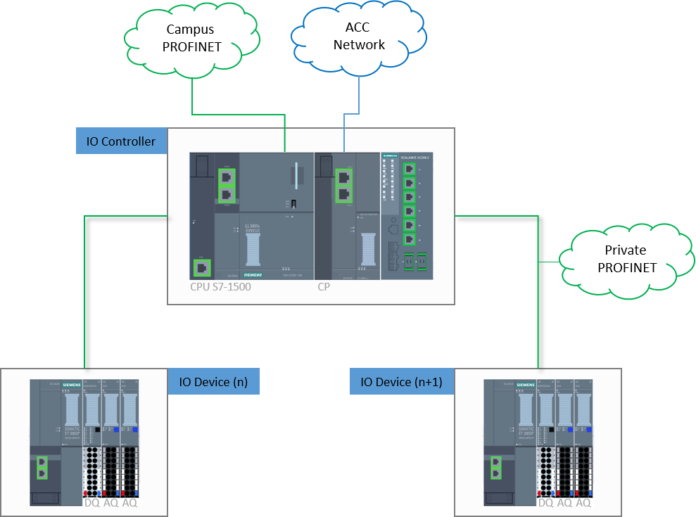
PLC
Description | Order number | Info
SITOP PSU200M, DC 24V/10 A | 6EP1334-3BA10 | Power supply
CPU 1512SP-1 PN | 6ES7512-1DK01-0AB0 | IO Controller (CPU)
CP 1542SP-1 | 6GK7542-6UX00-0XE0 | CP (ACC-Network)
IM 155-6 PN HF + Servermodul | 6ES7155-6AU00-0CN0 | IO Device (Interface)
BusAdapter 2xRJ45 | 6ES7193-6AR00-0AA0 | Bus Adapter
DQ 8x24VDC/0,5A HF | 6ES7132-6BF00-0CA0 | Digital Out - LED
AQ 2xU/I HF | 6ES7135-6HB00-0CA1 | Analog Out - Apertur

